Slide 1
Research Project
On
MBTI Personality Prediction From Social Networks Using Text Semantics
Under the guidance : Submitted By :
Dr. Deepali Kamthania Bhaswati Kalita
Professor MCA-5B
VSIT,VIPS 42717704418

Slide 2
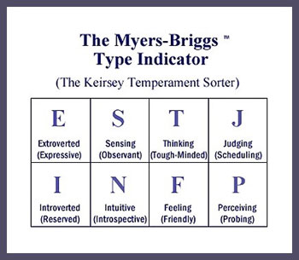
Introduction
MBTI personality types can be predicted through many ways. The most commonly used methodology has been questionnaires that are time consuming and needs the focus of participant. This project will explore the area of predicting personalities without questionnaires. People are increasingly using digital platforms like Facebook, twitter, etc. This gives us an opportunity to study if there’s a way to predict their personality through their status and posts using these platforms.

Slide 3

Objectives
Predicting MBTI personality type using texts from social medias.
Study the relation between natural language and MBTI personality.
Motivation
Limitation
Can be a contribution towards psychology.
Will help people know about themselves without solving a lot of questions.
Based on texts. It does not include images, videos, URLs, shared posts, etc.

Slide 4
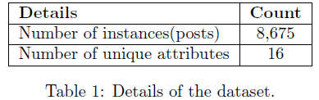

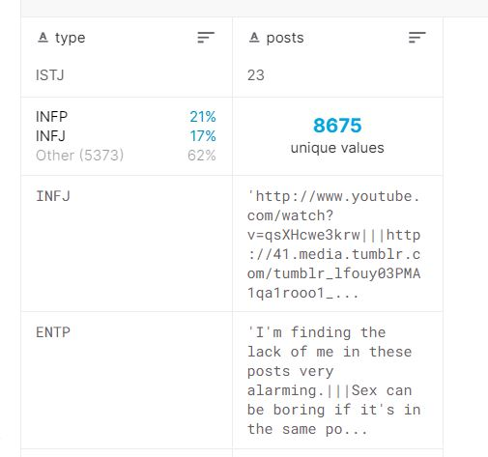
Dataset Description
used the Myers-Briggs Personality Type Dataset available on Kaggle
This data was collected through the PersonalityCafe forum that provides a large number of people,their respective MBTI personality types and what they have posted
Every dataset also comprises of data attributes. Table 2 describes attributes of data.
There are 50 posts separated by ‘|||’ for each personality type individual.
Attribute Description
I – Introversion, E - Extroversion, S – Sensing, N- Intuition, T- Thinking, F- Feeling, P-Perceiving, J- Judging
A combination of I or E, S or N , F or T and P or J gives us an MBTI personality.

Slide 5
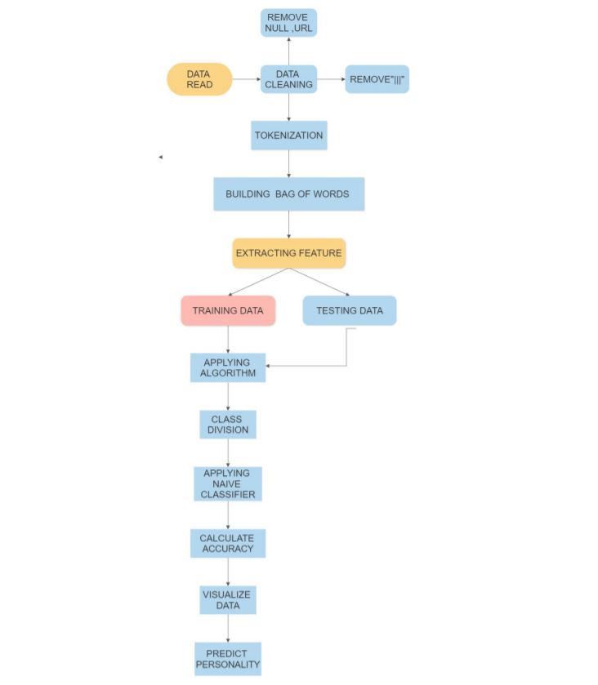
Methodology

Slide 6
Data Cleaning
removed URLs, NULL values and common fillers like “or” , “a”, “the”, etc.
replaced the null values with the hyphen symbol.
made a list of all the useless words (stop words).
Lemmatization
Process of reducing infected words to their meaningful word stem i.e. base word
Words on applying lemmatization word stem
History,historical => history
Finally,final,finalized => final
Going,goes,gone => go
We used imported WordNetLemmatizer from nltk.stem to lemmatize the text

Slide 7
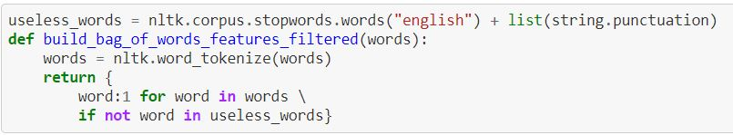
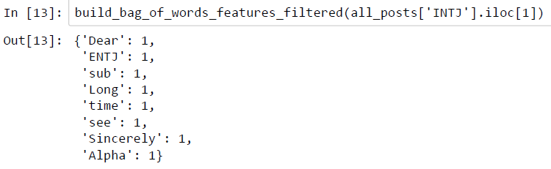
Tokenization
Given a paragraph of corpus/sentences, conversion of this paragraph into sentences and sentence to words, this is called tokenization
sent_tokenize is a function of nltk which takes a paragraph/corpus, applies lot of regular expression and convert paragraph into sentences
word_tokenize ->take paragraph and converts it into words
Bag Of words
converts text data into vectors(numerical format)
Function used:- countvectorizer performs bag of words

Slide 8
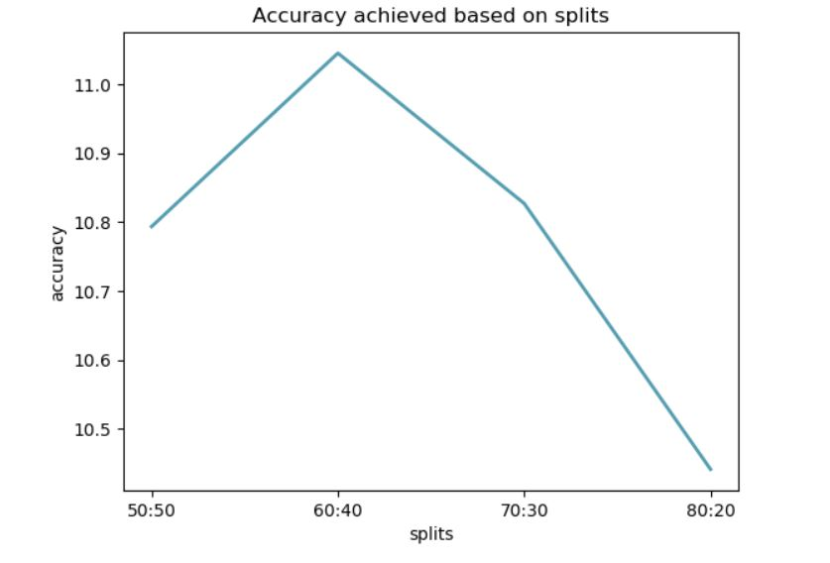
Model Creation
METHOD 1
Considered all the 16 MBTI personality types as 16 different classes and performed multi class classification.
Machine learning algo used : Naïve Bayes Classifier => baseline algo for textual data
Divided the dataset into training and test data .
Trained the dataset using NaiveBayesClassifier.train() function.
We divided the dataset first into 80:20 for training:testing i.e. 80% training data and 20% testing d ata then 70:30 , 60:40, 50:50 .

Slide 9
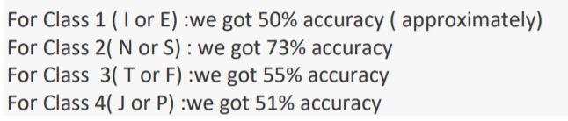
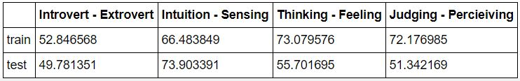
METHOD 2
Created 4 classifiers to classify the person.
Did binary classification individually on each of the 4 classes.
Combined the result to get a personality type.
New Accuracy
Summarising the result of the model
The accuracy of Naïve Bayes Classifier is around 53%.

Slide 10
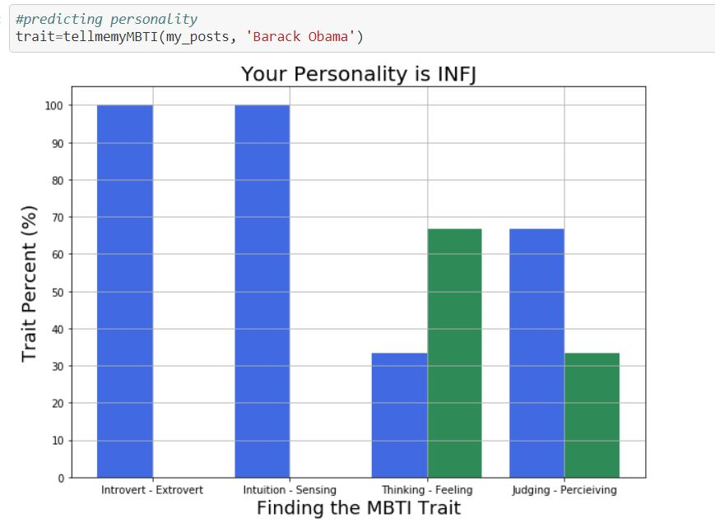
Results from Barack Obama’s tweets
MBTI of Barack Obama is INFJ

Slide 11
Original personality of Barack Obama is ENFJ MBTI Personality is INFJ: The Counselor 1. Sensitive to the needs of others 2. Reserved 3. Highly creative and artistic 4. Focused on the future 5. Values close, deep relationships 6. Enjoys thinking about the meaning of life 7. Idealistic
Results from Barack Obama’s tweets

Slide 12
Conclusion
There is a slight difference between the personality predicted by the model and the personality predicted by 16 personalities. This might be because we have not scraped the profile but have copied few posts of the user into the test file. We are using Naive Bayes classifier, the accuracy of which is 53%, so according to the accuracy of the model, we are getting a good result.
Data proportionalisation is necessary to remove the biases towards INFP.
People act differently on social medias. Thus, 100% accuracy is extremely difficult.
A study on what personality acts in what manner on social medias can be conducted.

Slide 13
Thank You!

